Slide 1
Analyzing King County Crime using Geographic Data
IBM Data Science Capstone Project

Slide 2
Analyzing Crime Rate Using Location Data is Valuable for
House buyers or renters who want to settle in relatively safe neighborhood can use this as a rough guidance by examining the surrounding venues.
Optimize allocation of police patrol resources based on surroundings in the locations.
Optimize use of County funds to improve public safety.
… and more

Slide 3
Data Source
King County Population by City: http://worldpopulationreview.com/us-counties/wa/king-county-population/
King County Sheriff's Office Crime Data: https://moto.data.socrata.com/dataset/King-County-Sheriff-s-Office/4h35-4mtu
Simplemaps Geographic Data: https://simplemaps.com/data/us-cities
FourSqure API Location Data: http://www.foursquare.com

Slide 4
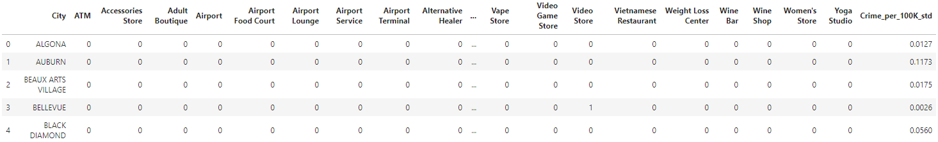
Final Dataset after Cleaning

Slide 5
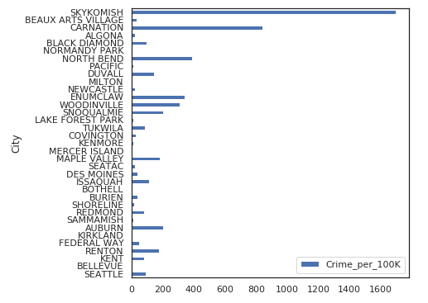
Crime per 100K Population by City
Incidents: 2019 Jan – August
Population: growth projected to 2018

Slide 6
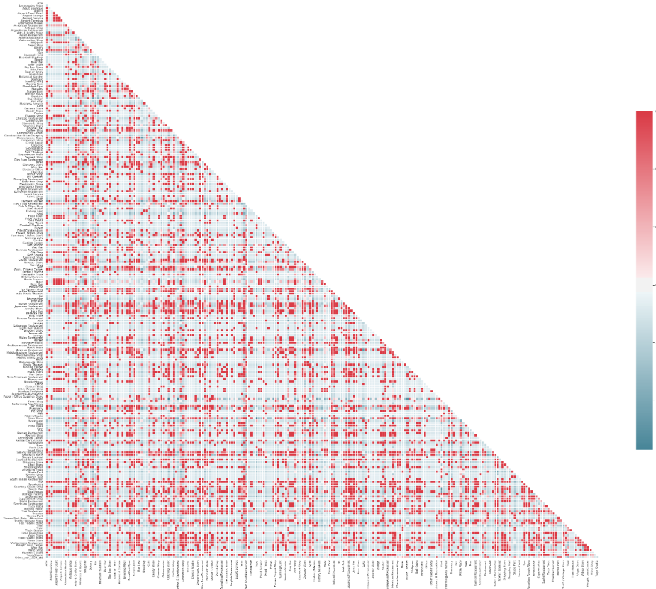
Correlation Matrix Heatmap
Low correlation between features and target due to sparsity
Some features are strongly correlated

Slide 7
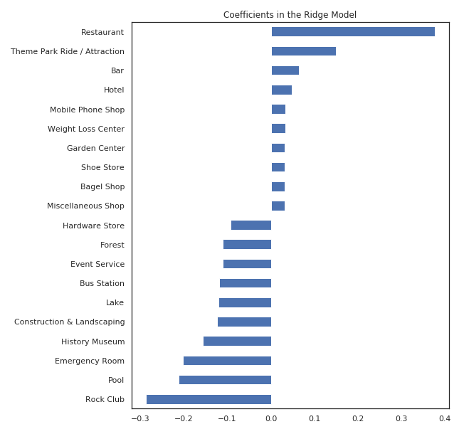
Ridge Regression
Cross Validation applied to determine the optimal tuning parameter Alpha
Most positive/negative coefficients: crime happen more frequently in neighborhoods that has more venues that people visit on daily basis
Model MSE: 0.0547

Slide 8
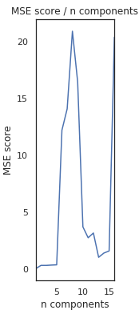
Principle Component Regression
Cross Validation applied to determine best n-components
Model MSE: 0.0569

Slide 9
Conclusions
Crime rate seems to be correlated with the venues data
Ridge regression seems to be better in terms of prediction
Ridge regression also yields interpretable results where we could see the most predictive features associated with crime rate
Venues that people visit on daily basis will have more crimes, whereas places that people don't visit regularly have less crimes

